Slide 1
Lecture 23: Frequency Response for Design
Relationship between time response and frequency response
Bode plots for controller design
Robustness and optimality

Slide 2
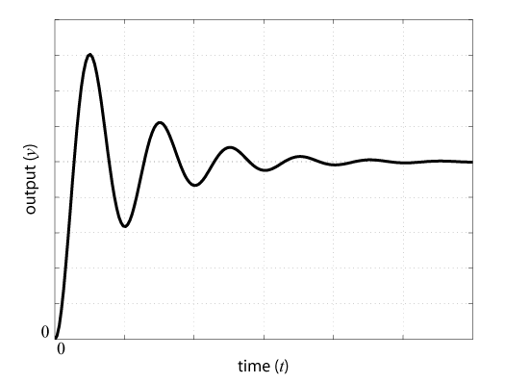
Relation Between Domains
Open-loop Frequency Response
Closed-loop Time Response

Slide 3
Relation Between Domains
OL Bode indicates CL time response properties
Steady-state performance:
Larger gain at DC reduces steady state error
DC gain of a type 0 system can be identified by the magnitude at small frequencies
Slope of magnitude at small freq indicates system type
Transient performance:
Smaller resonant peak and larger phase margin indicate smaller overshoot
Larger gain crossover frequency indicates faster response

Slide 4
Example
Determine an additional gain K that will increase the given system’s phase margin to 45 degrees
What is the effect on the system’s response?

Slide 5
Design with Frequency Response
Analyze time response behavior, determine deficiencies
Plot open-loop system’s frequency response
Add controller to change shape of frequency response plot
For Bode plots, controller’s graph literally adds to the plant’s (reason to use the open-loop for design)
Note: magnitude and phase plots are dependent
Iterate

Slide 6
Design with Frequency Response
Step 1
Step 2

Slide 7
Design with Frequency Response
Step 3

Slide 8
Bandwidth
Most analysis and design in frequency domain is done using the open-loop
One exception is bandwidth, which is a measure of the system’s (closed-loop) speed of response (relates to gain crossover freq)
Definition:
Bandwidth is the frequency at which the closed-loop magnitude plot drops to -3dB below its DC magnitude

Slide 9
Comparison
Advantages of Frequency Response
Richer source of information
Settles ambiguities from the root locus (higher-order dynamics, numerator dynamics)
Good for experimental derivation
Advantages of Time Response
Gives result directly in the time domain, ultimately what we want

Slide 10
Other Considerations
So far, we have mostly been concerned with achieving the least amount of error
Transient error
Steady-state error
Other concerns
Amount of control effort
Robustness
Can define optimality in terms of a balance of these concerns

Slide 11
Control Effort
Large control effort often means increased cost
Means more power/fuel required
Larger peak effort requires a larger actuator
In general, faster response requires more control effort

Slide 12
Robustness
Robustness defines how well a system will perform in the presence of
Measurement noise
Disturbances
Model uncertainty
Time delays
In general, there is a tradeoff between robustness to various sources

Slide 13
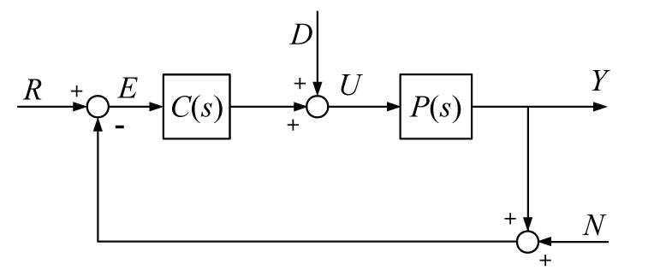
Robustness
Consider

Slide 14
Robustness
Note, all three transfer functions have the same denominator
Also
Therefore, these transfer functions are not independent

Slide 15
Robustness
For example,
Making C → ∞
G_{yd} → 0
G_{yn} → -1
Making C → 0
G_{yd} → P
G_{yn} → 0
Problem, can’t attenuate both noise
and disturbances at same time

Slide 16
Robustness
One solution relies on the fact that our systems behave differently at different frequencies
Therefore, we will attenuate noise at high frequencies and disturbances at low frequencies
Desired open-loop magnitude plot is thus
M(dB)
ω(rad/sec)

Slide 17
Robustness
This approach is also desirable because models tend to be most uncertain at high frequencies
M(dB)
ω(rad/sec)

